Slide 1
Park-Me
Team 5: Cassandra Lundberg, JT Whetstone, Shriya Vaagdevi Chikati, Wenzhuo Zhao

Slide 2
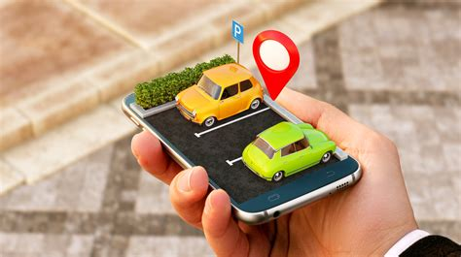
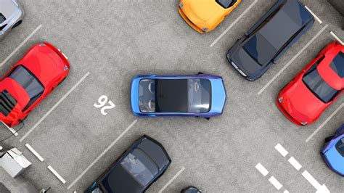
Purpose
To find and show available parking spots in different GSU parking decks
The app will direct the user to an open space
The user has the option to reserve an open space ahead of time
This saves time hunting for an available spot

Slide 3
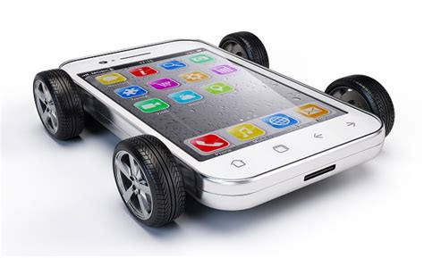
Technical Platform
The user would sign into their GSU account on their mobile device
This then allows the user access to the parking and transportation user interface
Parking and transportation UI gain access to the main parking system data store
Main parking system can then verify through the financial system data storage, the user’s payment information
After payment is validated the secondary system GPS API can be used by the main parking system to generate a route to desired parking deck
If parking spot was reserved GPS can then direct to parking spot

Slide 4
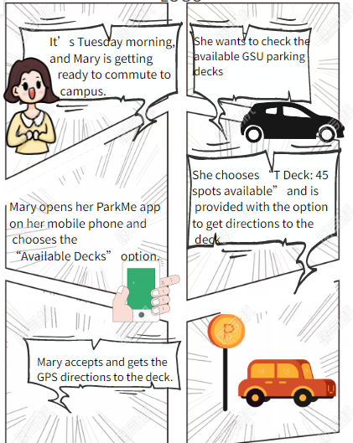
Story Board 1

Slide 5
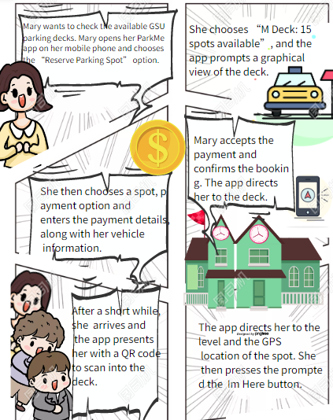
Story Board 2

